Slide 1
Free Whelling Diode

Slide 2
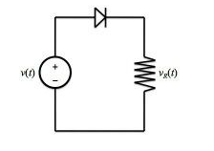
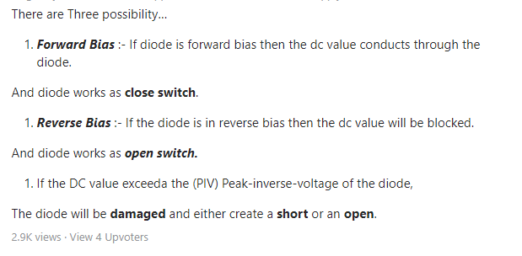

Slide 3
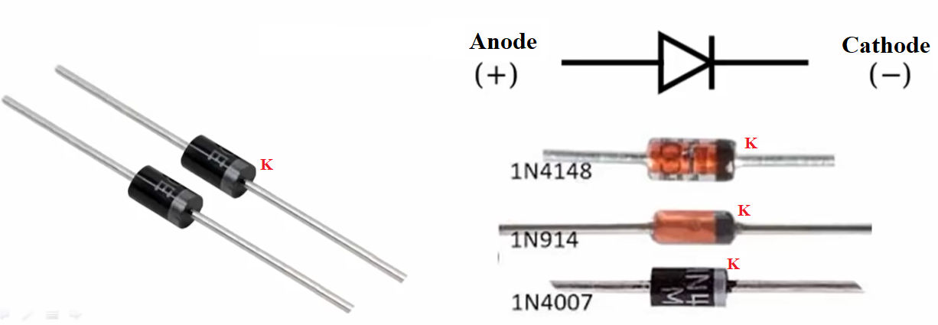
DIODE
A diode is a device which allows flow of current in one direction. It is a polarized component with two leads, called the cathode and the anode. The cathode is normally marked with a silver or colored band.

Slide 4
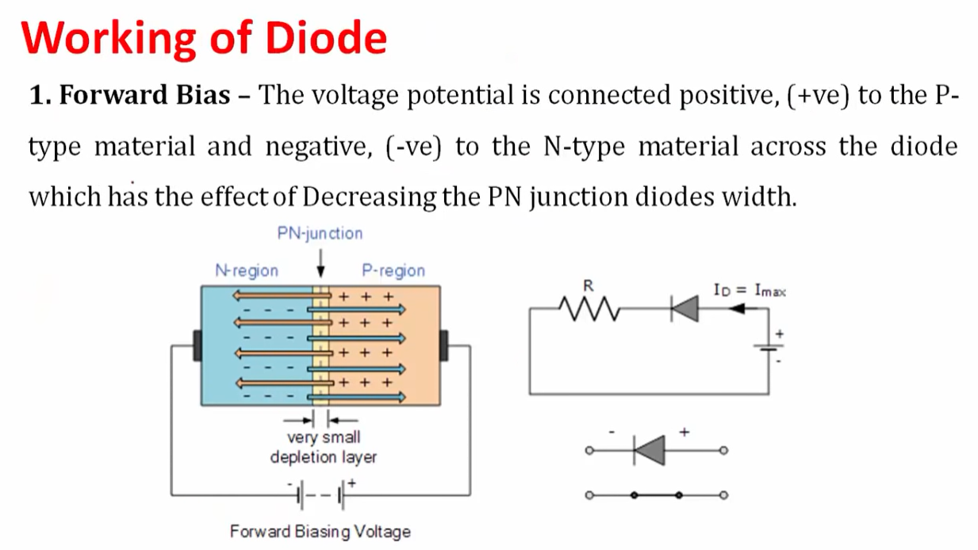

Slide 5
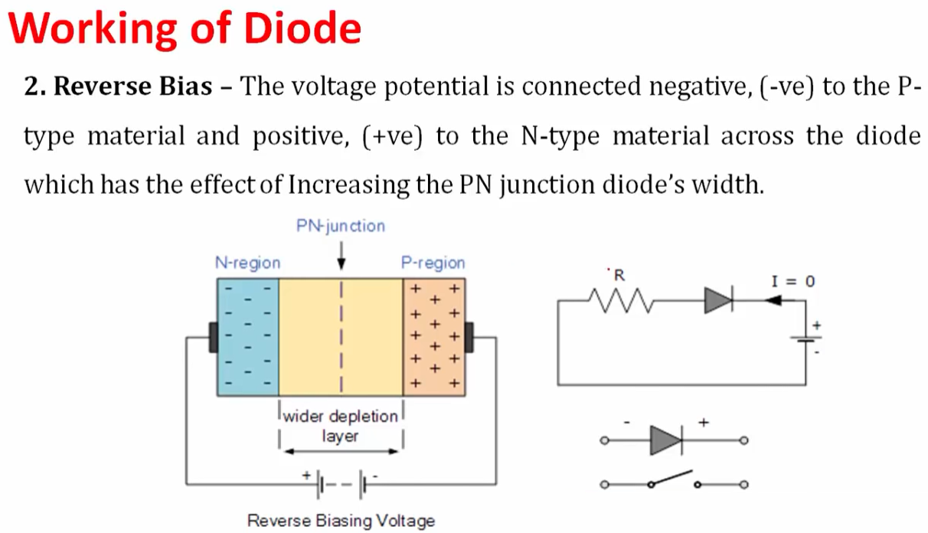

Slide 6
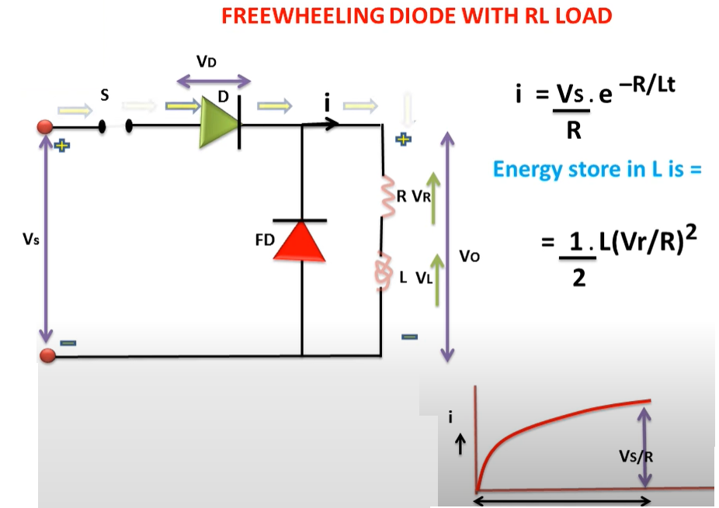
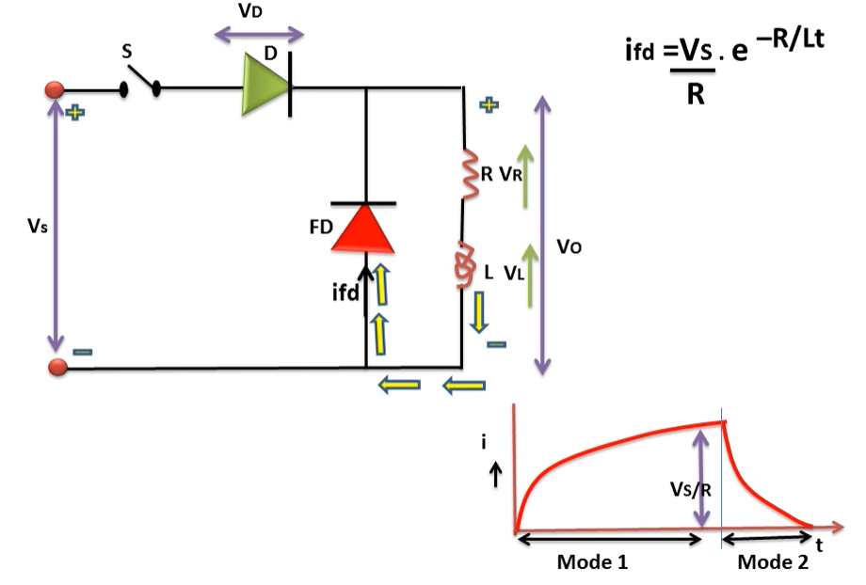
FreeWheelling Diode

Slide 7
A diode is defined as a two-terminal electronic component that only conducts current in one direction (so long as it is operated within a specified voltage level). An ideal diode will have zero resistance in one direction, and infinite resistance in the reverse direction.
Although in the real world, diodes can not achieve zero or infinite resistance. Instead, a diode will have negligible resistance in one direction (to allow current flow), and very high resistance in the reverse direction (to prevent current flow). A diode is effectively like a valve for an electrical circuit.
Semiconductor diodes are the most common type of diode. These diodes begin conducting electricity only if a certain threshold voltage is present in the forward direction (i.e. the “low resistance” direction). The diode is said to be “forward biased” when conducting current in this direction. When connected within a circuit in the reverse direction (i.e. the “high resistance” direction), the diode is said to be “reverse biased”.

Slide 8
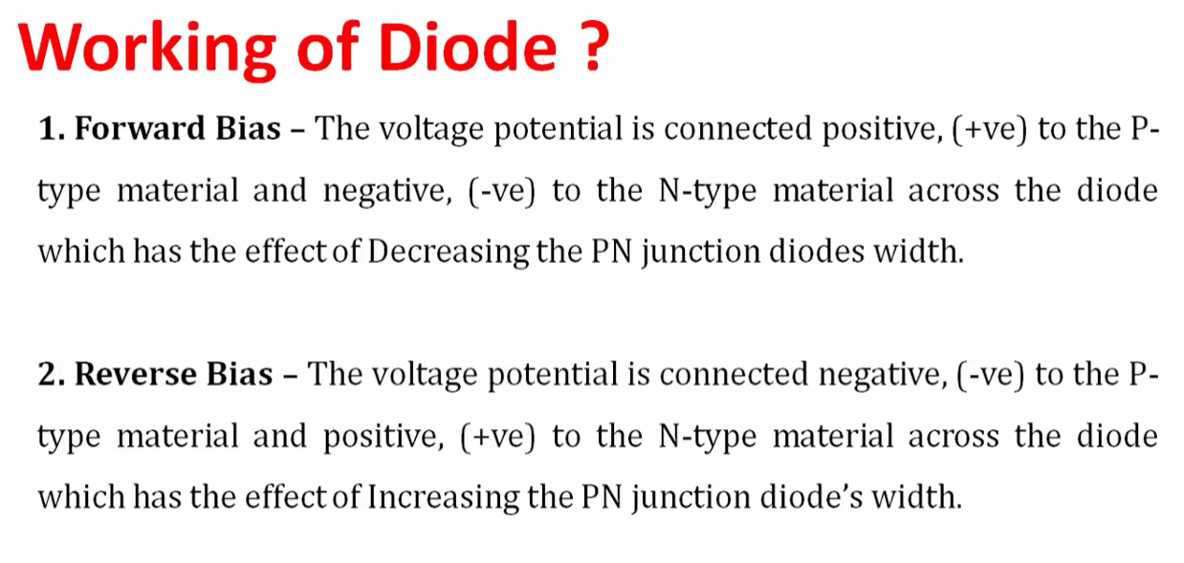

Slide 9
A diode is connected in series with a resistor because a diode essentially acts like a short while forward biased and a open when reverse biased, when a diode is forward biased its resistance is very very low so it will produce a very high circuit current if a resistor is not added in series to increase the total circuit resistance and reduce the current. Unless the diode and source are specifically made to operate at very high circuit currents having just a diode connected by itself is a bad idea.

Slide 10
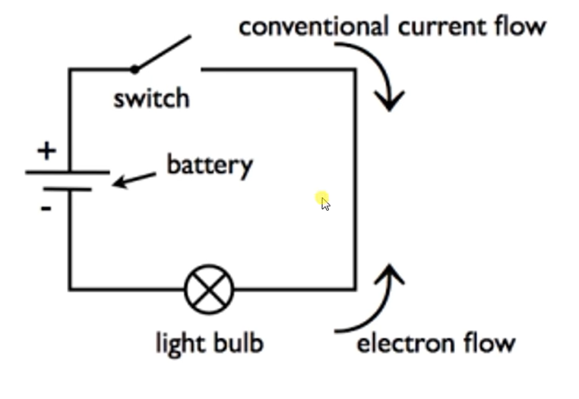

Slide 11
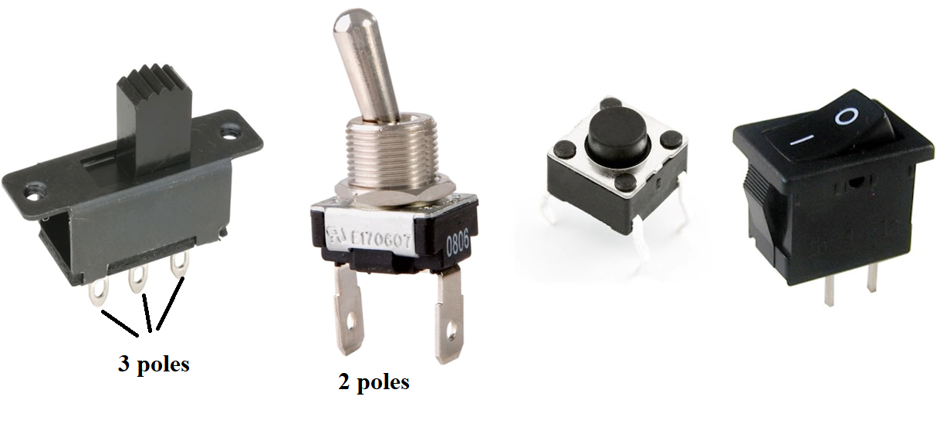

Slide 12
SPST = Single Pole Single Throw switch
SPDT = Single Pole Double Throw switch
DPST = Double Pole Single Throw switch
DPDT = Double Pole Double Throw switch

Slide 13
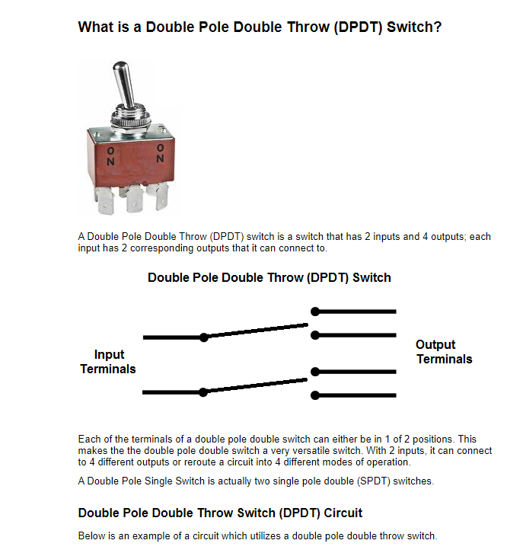

Slide 14
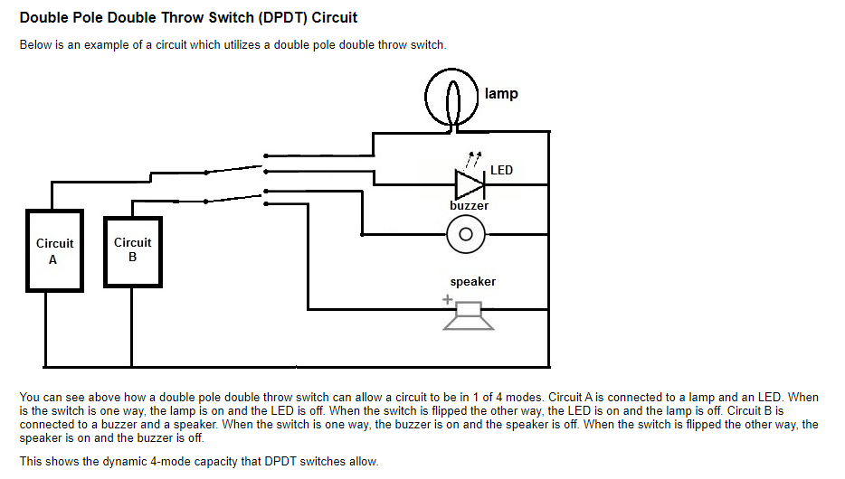

Slide 15
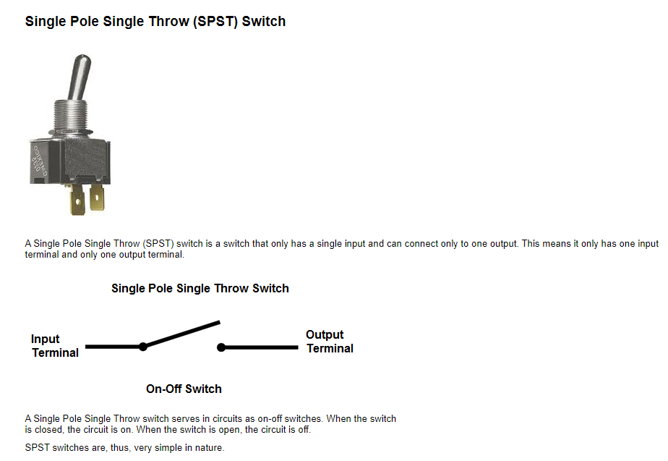
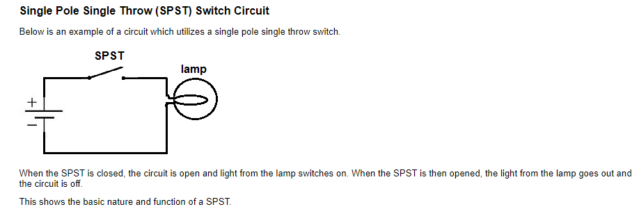

Slide 16
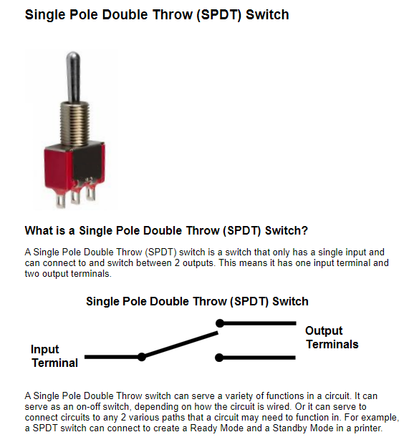
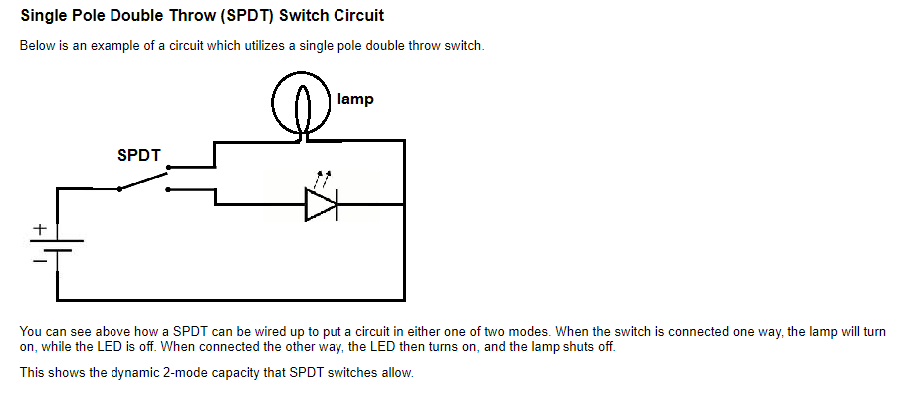

Slide 17
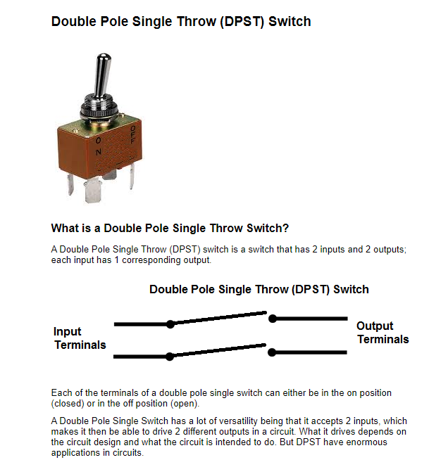
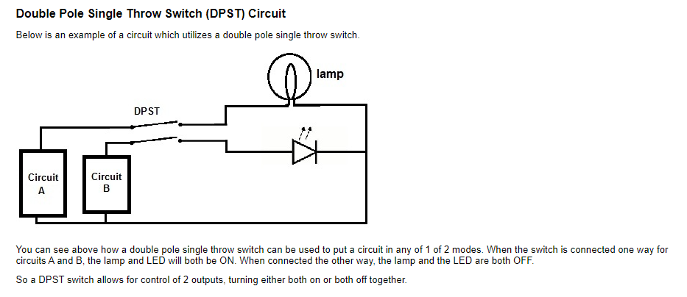

Slide 18
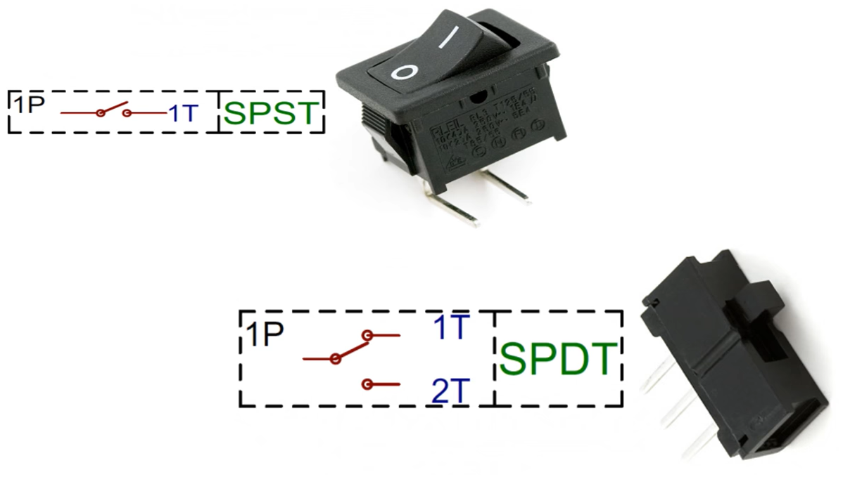

Slide 19
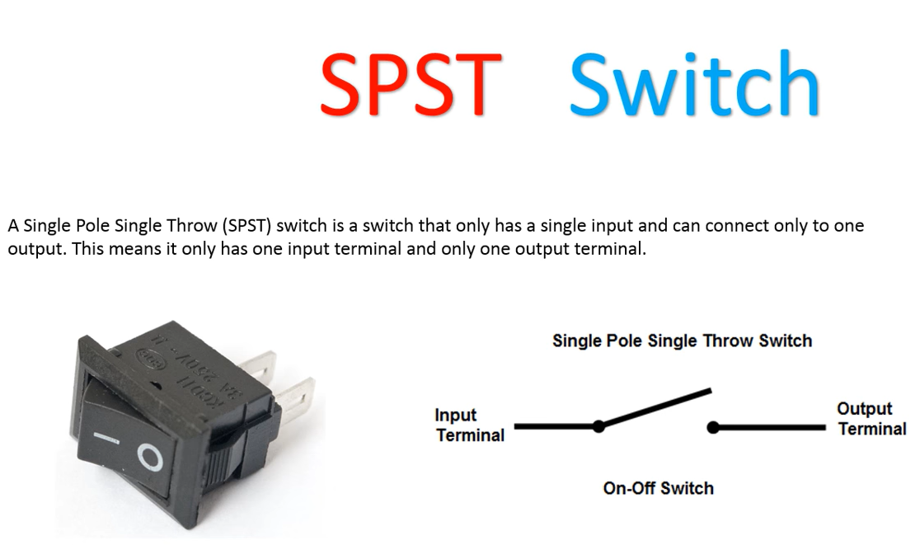

Slide 20
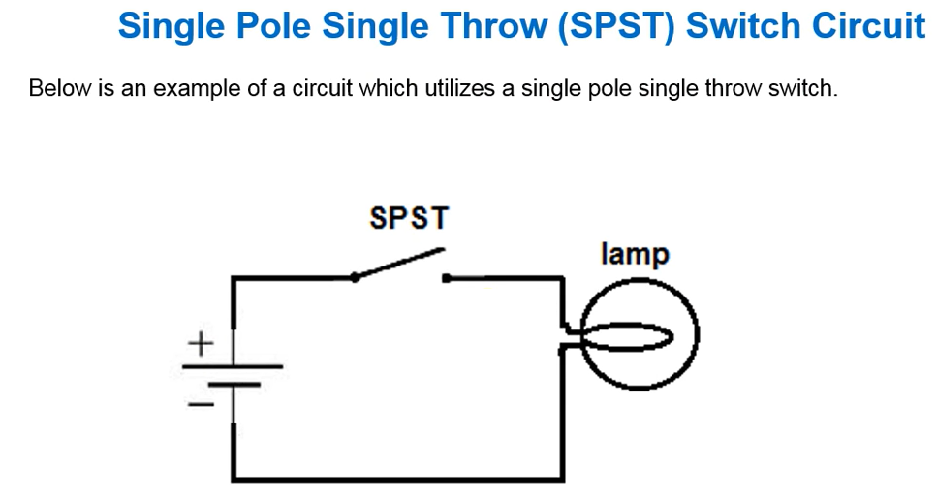
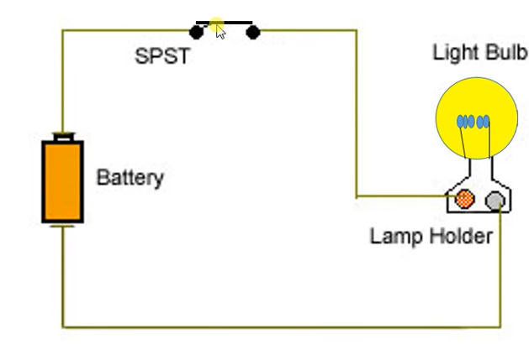

Slide 21
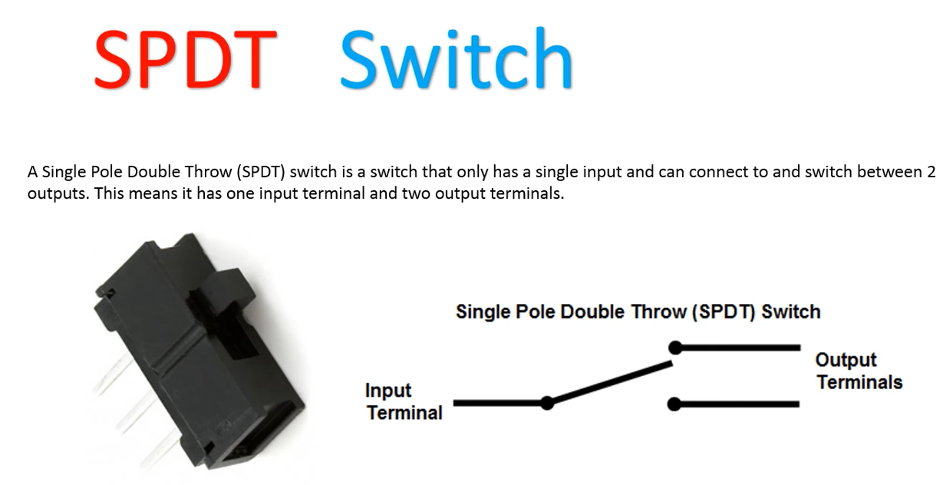

Slide 22
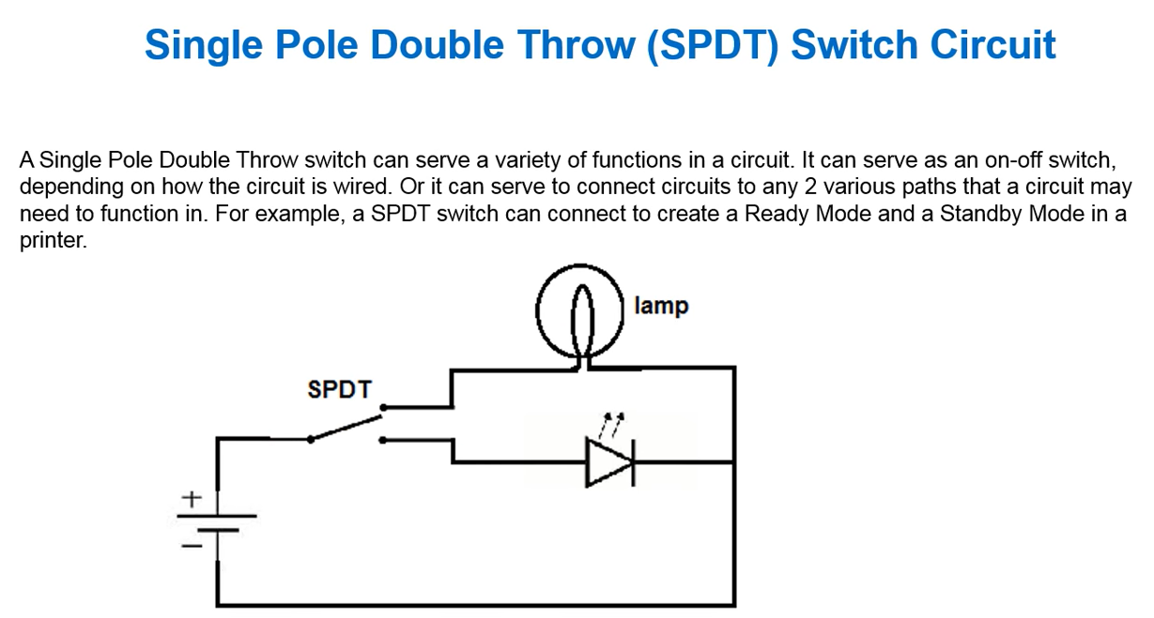

Slide 23
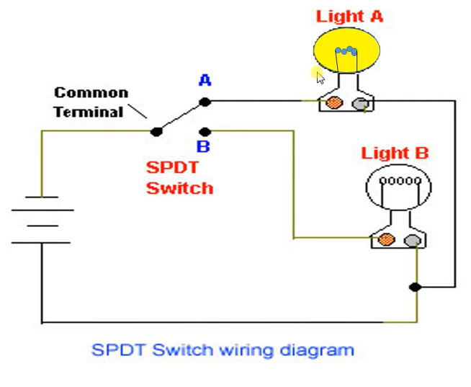
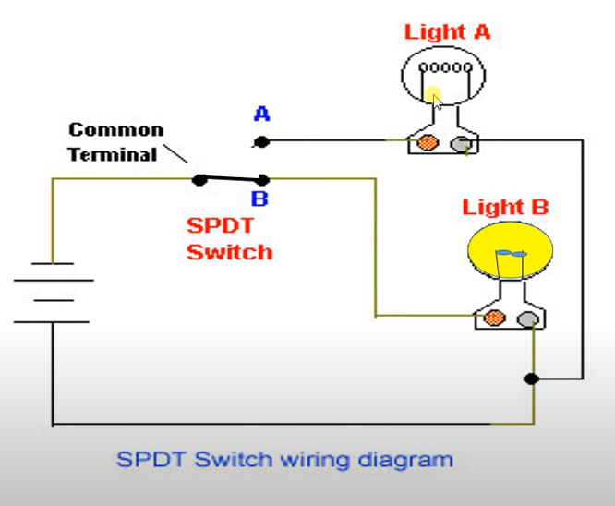

Slide 24
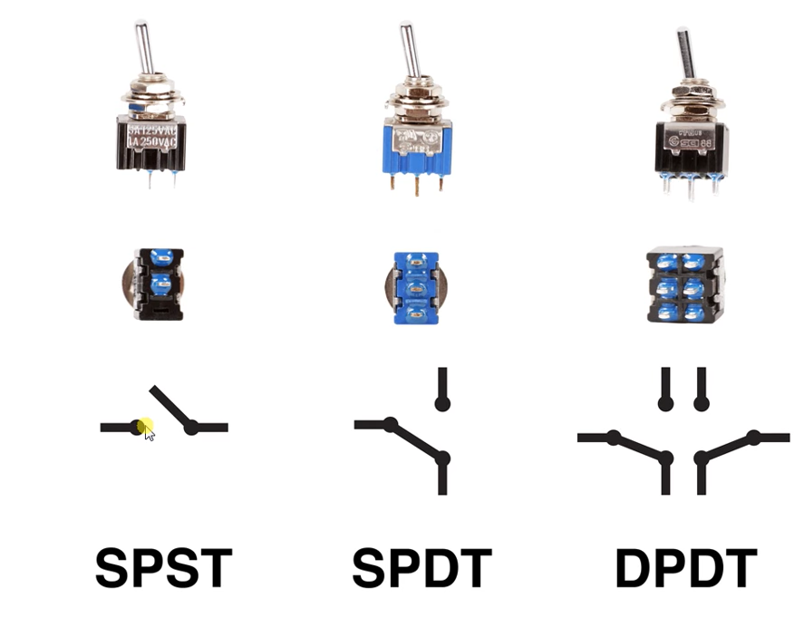

Slide 25
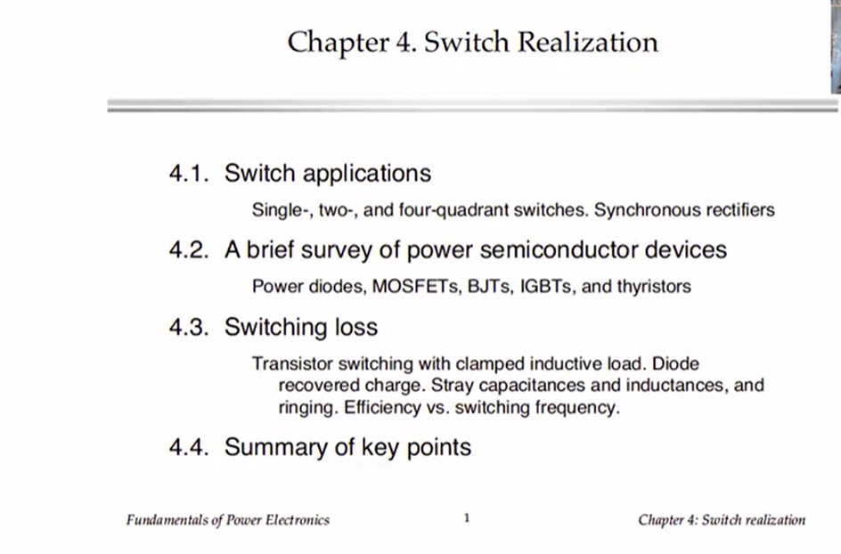

Slide 26
BUCK AND BOOST CONVERTER used to Convert DC to Low DC

Slide 27
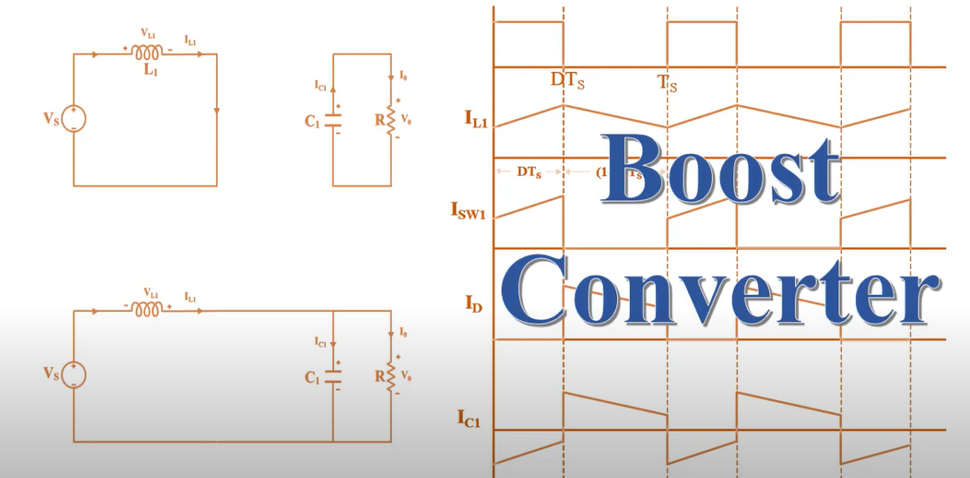
BOOST CONVERTER(It is also called Step up Converter) O/P is greater than I/P Voltage

Slide 28
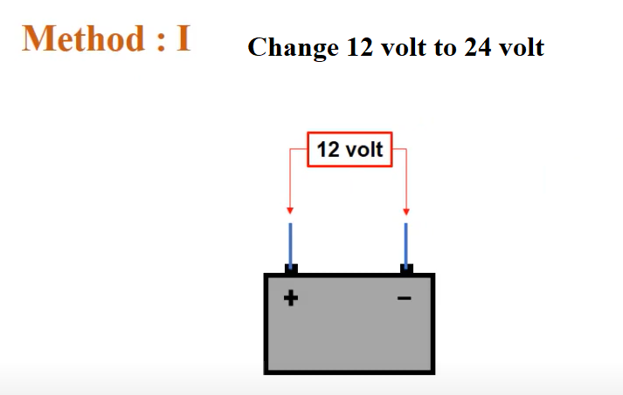

Slide 29
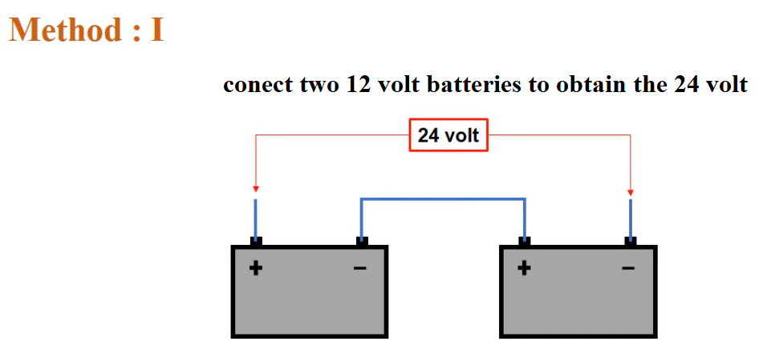

Slide 30
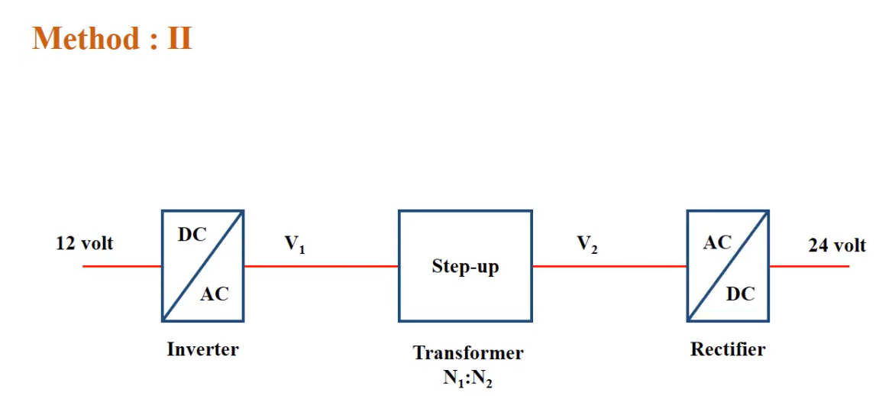
Bulky
Inefficient
costly

Slide 31
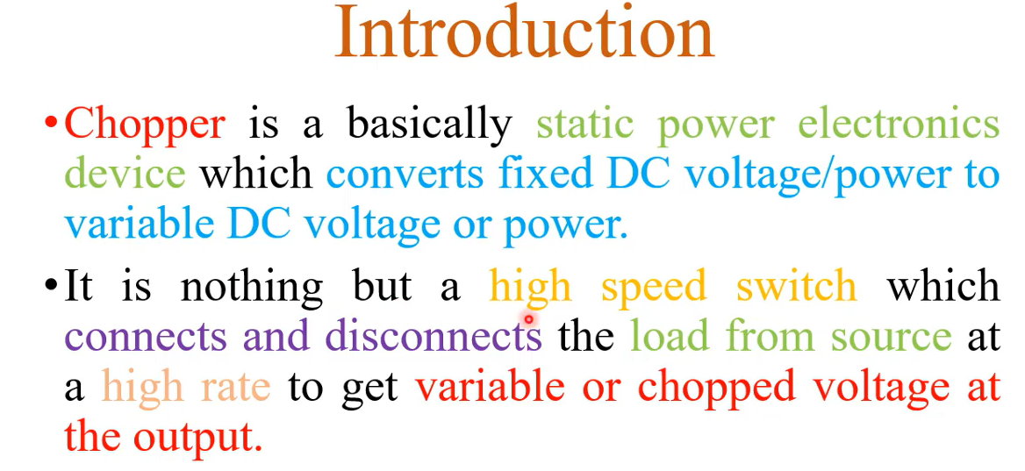

Slide 32
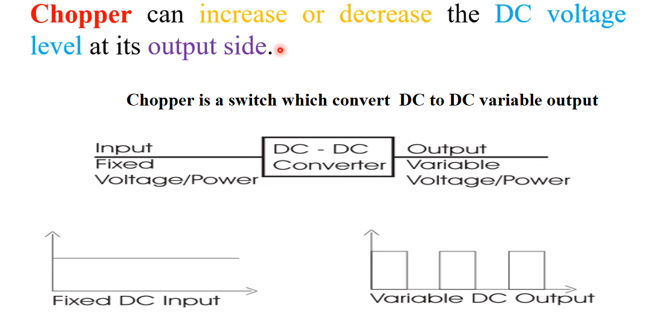

Slide 33
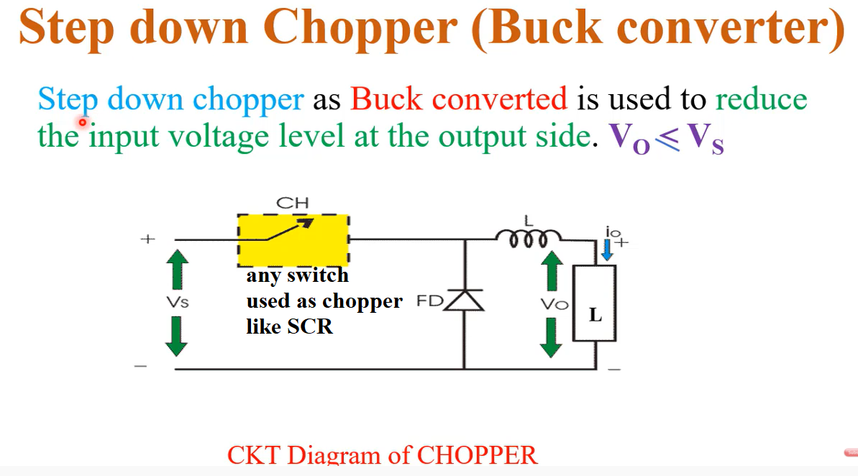

Slide 34
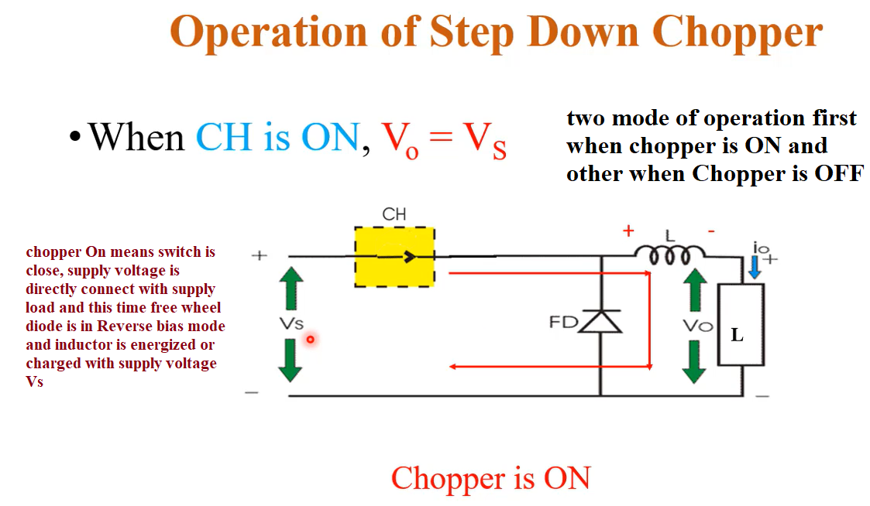
https://www.youtube.com/watch?v=9zWIymt2_fY

